Slide 2



Etrieve Forms Security Training
This presentation is CONFIDENTIAL and property of Softdocs, Inc. It is to be used only for the purpose intended. Any unauthorized use is strictly prohibited. © 2017 Softdocs, Inc.

Slide 3
Agenda
Etrieve Security for Central Users
Etrieve Security
Creating & Setting up a Role
Form Privileges
Flow Privileges
Creating & Setting up a Group
Groups for Flow Only
Users, Groups, & Role Relationships
User Imports

Slide 4
Etrieve Security

Slide 5
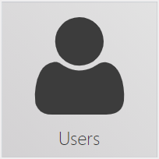


Etrieve Security
Grouping of like Users’ Permissions
Users go in Groups
Permissions go on Roles
Roles go on Groups

Slide 6
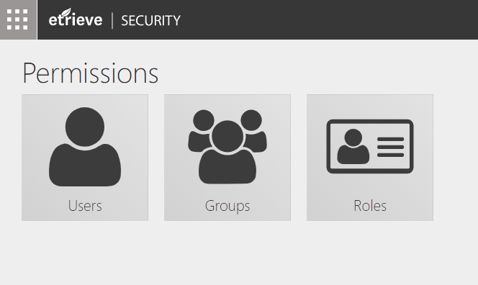
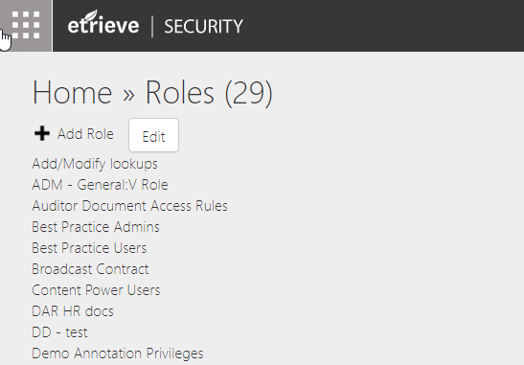
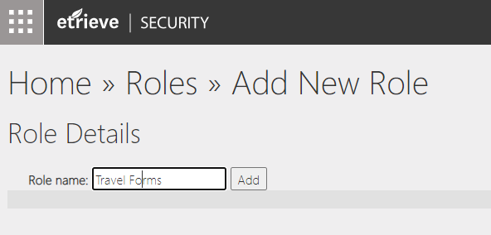
Creating & Setting up a Role
Click on the Roles tile in Etrieve Security
Click on Add Role to add a new Role
Enter a Role name and click the Add button

Slide 7
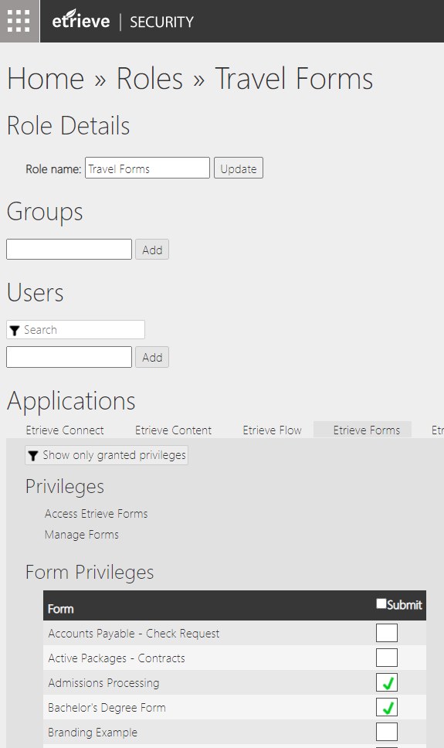
Creating & Setting up a Role
Select the Privileges to be granted by the Role

Slide 8
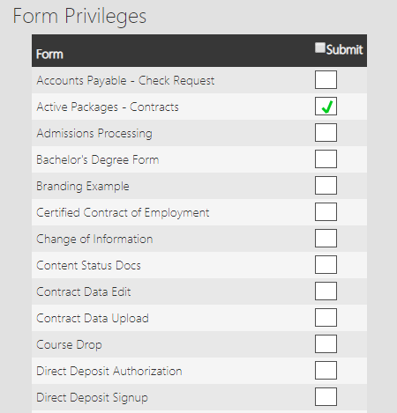
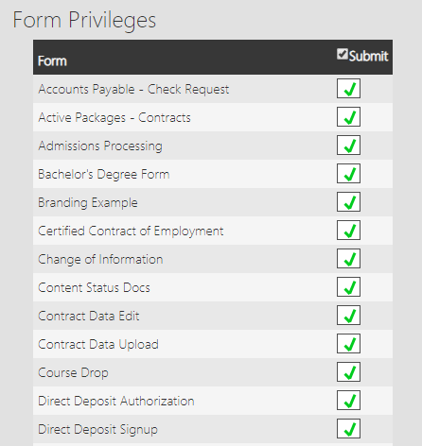
Forms Privileges
Individual Form Access
All Form Access

Slide 9
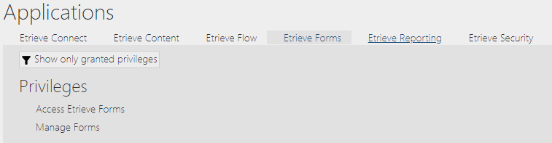
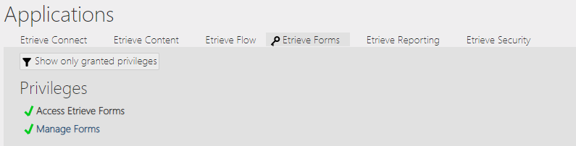
Additional Forms Privileges
Access to Forms (Forms & Drafts)
Create, Edit, Delete Forms – Administrators Only

Slide 10
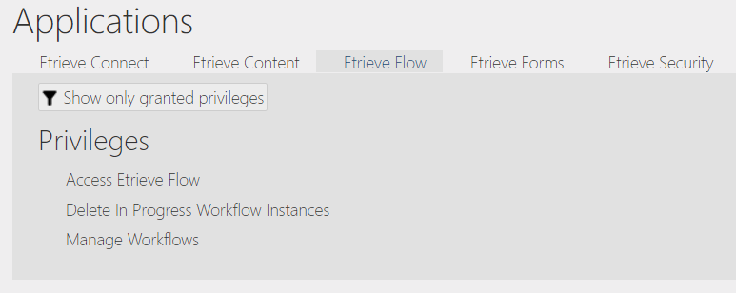
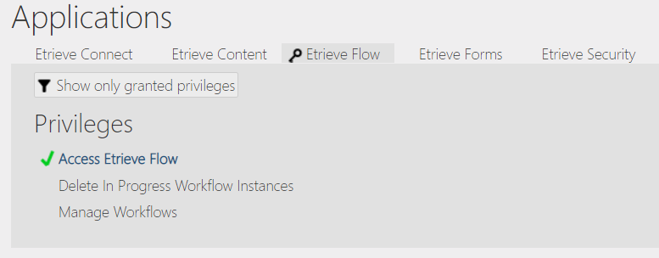
Flow Privileges
Access to Flow (Inbox & Activity)
Ability to Delete Packages – Administrators Only
Create, Edit, Delete and Monitor all Workflows – Administrators Only

Slide 11
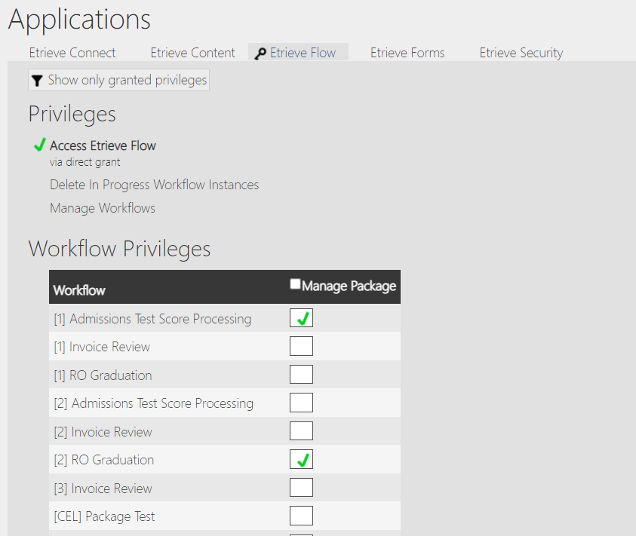
Workflow Monitor Privileges
Users must have access to Etrieve Flow and the specified Workflow to view & manage the packages within Workflow Monitor

Slide 12
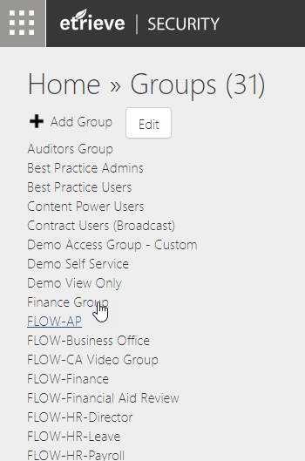
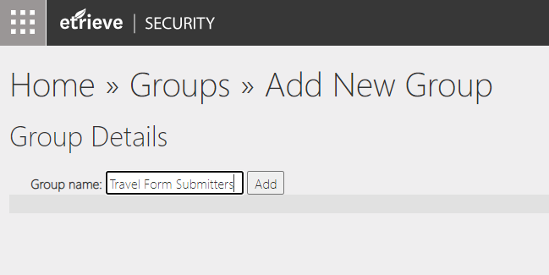
Creating & Setting up a Group
Click on the Groups tile in Etrieve Security
Click on Add Group to add a new Group
Enter the name of the Group and click the Add button

Slide 13
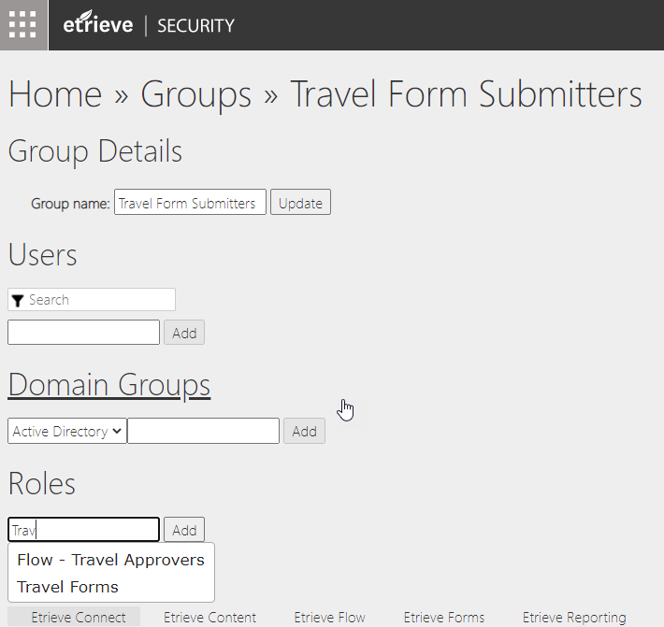
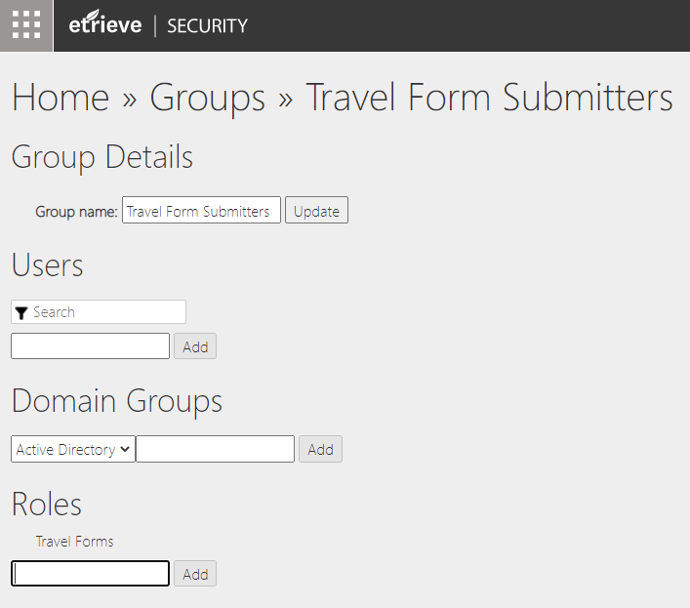
Creating & Setting up a Group
Associate Users to the Group directly or by associating an SSO Domain Group
Associate the Role(s) to the Group

Slide 14
Groups for Flow Only
Groups of Users assigned to Workflow steps
Typically do not have associated Roles
Use a standard prefix to differentiate from Groups that assign Privileges via Roles
e.g., FLOW-, WF-, etc.
Users can be assigned directly or via Domain Groups

Slide 15
Users, Groups, & Role Relationships
Group
Students
Employees
Teachers
Human Resources
User
Student
Employee
Teacher
Etc.
Role 1
Gaining access to Etrieve Central
Role 2
Gaining access to submit specified form(s)

Slide 16
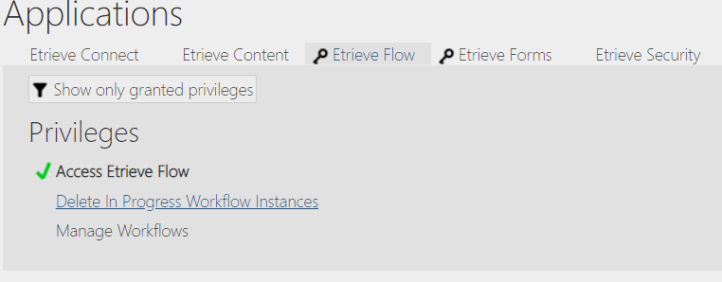
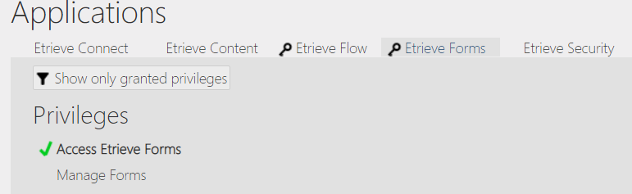
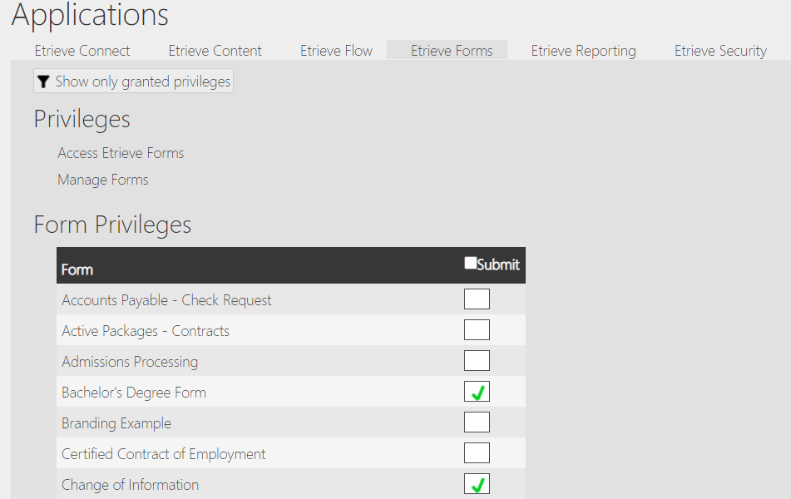
Users, Groups, & Role Relationships
Student User:
Billy
Bobbie
Ben
Bette
Group
Students
Access Etrieve Central
Access Flow
Access Forms
Employee User:
Caitlyn
Carrie
Chris
Billy
Group
Employees
Student Forms
Submit Student Forms
Employee Forms
Submit Employee Forms

Slide 17
User Imports

Slide 18
User Imports
Used to create Etrieve User Records
Can also be used to update:
Active Status on User Account
Personal Identifiers
Assigned Groups
Assigned Roles
Custom Properties
Records are imported via a tab-delimited text file
Can be run manually or by scheduled process
Full documentation can be found here:
https://community.softdocs.com/s/article/Etrieve-User-Imports

Slide 19
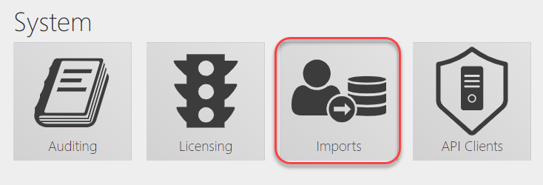
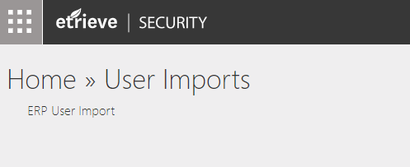
User Imports
To run a User Import manually, create the import file and place in the import directory defined in the import configuration.
Click ERP User Import to execute the import process

Slide 20
User Imports
Caveats for User Imports
Cannot be used to update User’s Username
Group updates will append new Groups to User record
Active Status value only applies to Etrieve Authentication
Custom Property updates replace existing values with new values

